Slide 1
Software Product Management Design thinking
Nandagopal Govindan

Slide 2
Contents
Introduction
Steps in Design thinking
Examples
Case study

Slide 3
Introduction
Design thinking is a human-centered approach to innovation—anchored in understanding customer’s needs
Design thinking believes that Innovation is powered by a thorough understanding, through direct observation, of what people want and need in their lives

Slide 4
5 steps of Design Thinking
Empathize: Understanding the user and the problems they face through conducting user interviews, creating empathy maps, and listening to user stories.
Define: Organizing and analyzing the research information to produce a concise problem statement and possible solution or hypothesis.
Ideate: The brainstorming phase. Designers think of a wide variety of possible solutions and evaluate each one.
Prototype: Turning ideas into a physical representation of the product that will solve the user’s needs, slowly adding greater detail and complexity as designers move between testing and iteration.
Test: Putting the prototype in the hands of the user and determining whether the product has solved the problem at hand and reduced friction or frustration.

Slide 5

Example of design thinking at Kaiser hospital
Problem statement
At Kaiser hospitals, nurses routinely spent the first 45 minutes of each shift at the nurses’ station, debriefing the departing shift about the status of patients
Nurses often failed to learn some of the things that mattered most to patients, such as how they had fared during the previous shift, which family members were with them, and whether or not certain tests or therapies had been administered.
For many patients, each shift change felt like a hole in their care.

Slide 6
Example of design thinking at Kaiser hospital
Solution
The design that emerged for shift changes had nurses passing on information in front of the patient rather than at the nurses’ station.
In only a week the team built a working prototype that included new procedures and some simple software with which nurses could call up previous shift-change notes and add new ones.
They could input patient information throughout a shift rather than scrambling at the end to pass it on.
The software collated the data in a simple format customized for each nurse at the start of a shift.
The result was both higher-quality knowledge transfer and reduced prep time, permitting much earlier and better-informed contact with patients.

Slide 7
Example of design thinking at Kaiser hospital
Method
The core project team included a strategist (formerly a nurse), an organizational-development specialist, a technology expert, a process designer, a union representative, and designers from IDEO.
This group worked with innovation teams of frontline practitioners in each of the four hospitals
Close observation, combined with brainstorming and rapid prototyping, produced new procedures and software that radically streamlined information exchange between shifts.

Slide 8
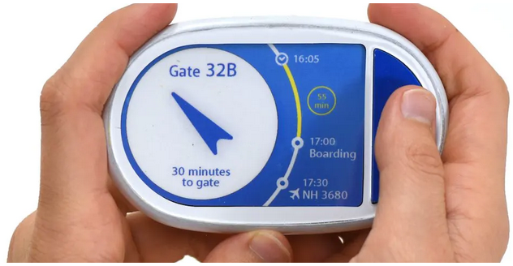
Case study: ANA Tomo
A travel companion for the elderly to navigate through the airport

Slide 9
Case study: ANA Tomo
Challenge
ANA is Japan’s biggest airline.
Has a large pool of businessmen customers
ANA seeks to adjust to Japan’s upcoming demographic circumstances: the aging society.
ANA wants to cherish the retired businessmen who accompanied ANA throughout their careers

Slide 10
Case study: ANA Tomo
Solution
ANA Tomo, best travel companion.
ANA Tomo is a portable connected object designed with the active retiree in mind.
It serves ANA elder passengers with live navigation to their boarding gate at the airport.
ANA Tomo also gives passengers relevant, informative cues, ensuring ANA is by its customers’ side throughout their journey.

Slide 11
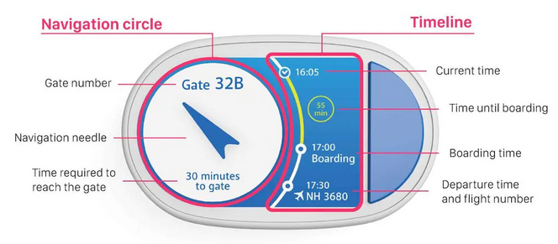
Case study: ANA Tomo

Slide 12
Case study: ANA Tomo
Impact
Easily understood by all passengers, ANA Tomo allows them to enjoy their time at the airport while approaching their gate at their own pace, stress free
ANA can find passengers in case they are lost, speeding up the boarding process.
Currently the device is being designed for the duration of one's stay in the airport, but future expansions can include the duration of the flight and even the duration of one's travel. ANA Tomo can easily become the future air ticket.
Ref: https://sugar-network.org/
https://www.me310kyoto.org/anatomo

Slide 13
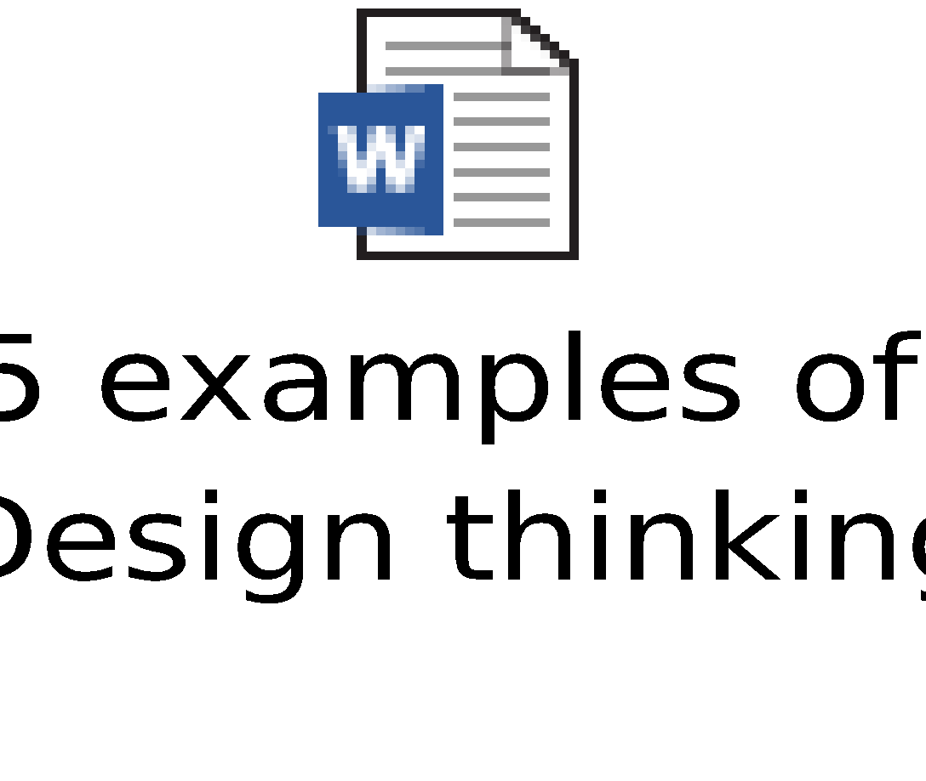
Case study: UberEats
UberEats:
What are the key learnings from the UberEats example?

Slide 14
Key takeaways from the 5 examples:
Whether it’s a new app, a community service, or a physical product, the best thing you can do to innovate successfully is keep your user in mind at every step in the design process. It can be tempting to create a flashy, high-tech product.
Instead, focus on what your users are asking for.
It’s easy for designers to become disconnected from their user. Don’t be afraid to take risks and immerse yourself in the lives of the people who will actually interact with your product. Then implement their feedback and test your results. Eventually you’ll land on that final iteration with the potential to change the world around you.
https://careerfoundry.com/en/blog/ux-design/design-thinking-examples/

Slide 15


Homework case studies
What are the ley learnings from these case studies in the area of understanding customer needs, ideation, prototyping, iteration?
Case studies from IDEO company

Slide 16
Appendix

